Slide 1
LOM Workshop, RSMAS/University of Miami, 1-3 June 2009 On the Development of a Numerical Ocean Prediction System for the Atlantic Based on HYCOM Clemente A. S. Tanajura¹, Renato Ramos da Silva, Jonatas Einsiedler, Giovanni Ruggiero, Konstantin Belyaev, Jean F. de Oliveira, Edmo Campos, Mariela Gabioux, Afonso Paiva, Charles Santana ¹Departament of Earth Physics and Environment / Physics Institute and Center for Geophysics and Geology Research Federal University of Bahia (UFBA)
Collaboration: E. Chassignet, A. Srinivasan, A. Wallcraft
UFBA

Slide 2
The present work is part of the activities of the
Research Network on Oceanographic Modeling and Observation
FURG
www.rederemo.org
(under construction)

Slide 3
REMO Goals
To do research in physical oceanography over the Tropical and South Atlantic with emphasis in the region along the Brazilian shore
Develop technology in ocean modeling, data assimilation, forecasting and observation
Implement an operational numerical ocean forecast system for the regions of interest with ROMS, POM and HYCOM in the Brazilian Navy – Directorate of Hydrography and Navigation (DHN)
Support off-shore oil production by Petrobras, navigation, environmental monitoring, military activities, etc.
Support trainning and education

Slide 4
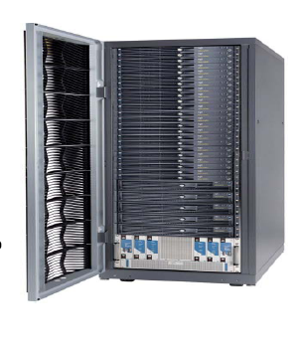
Cluster Netuno in NCE/UFRJ 256 nodes with a total of 2048 Intel Xeon 2.66GHz processors and 4 TB of distribute memory in partneship with the Research Network in Applied Geophysics.
Each participating institution has its computational facilities for REMO with about 40 processors.
In UFBA, we have a SGI with 8 cores Intel Xeon Quad-core 3GHz 16 GB RAM, 12 TB storage upgrading to 48 TB this month.
Moored buoys developed in UFRJ and deployed by the Brazilian Navy (DHN)

Slide 5
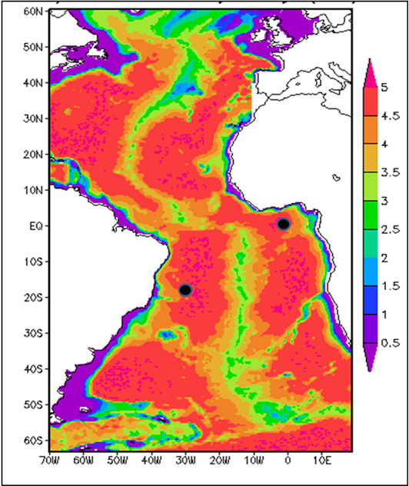
Preliminary steps toward operational forcasts with HYCOM
30 year spin-up run (1/3º resolution and 22 layers) from rest with Levitus T-S climatology forced with COADS climatological data of precipitation, 2m air temperature, 2m air mixing ratio, surface wind stress, longwave and shortwave radiation at the surface
4 years during 2007 with NCEP atmospheric reanalysis

Slide 6
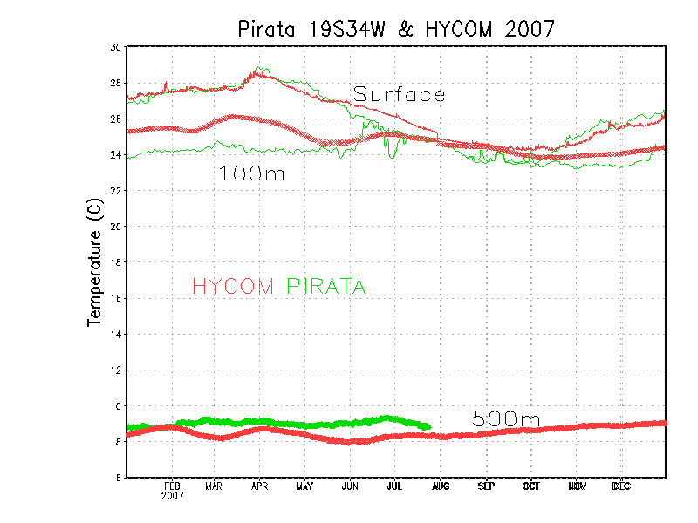
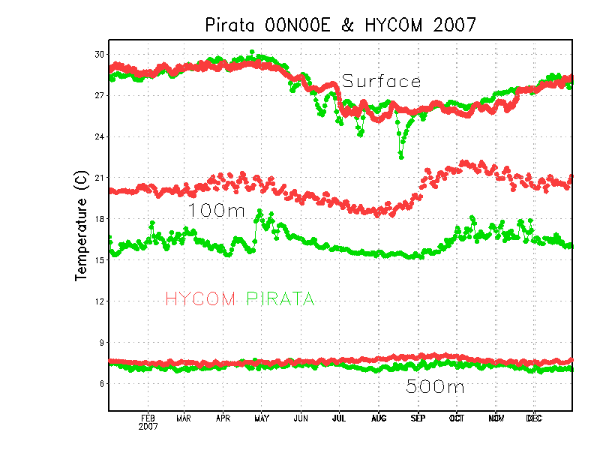
The 2007 had strong warm bias in the equatorial thermocline, but close to Brazilian shore they were much better.
30
30
24
24
9
8

Slide 7
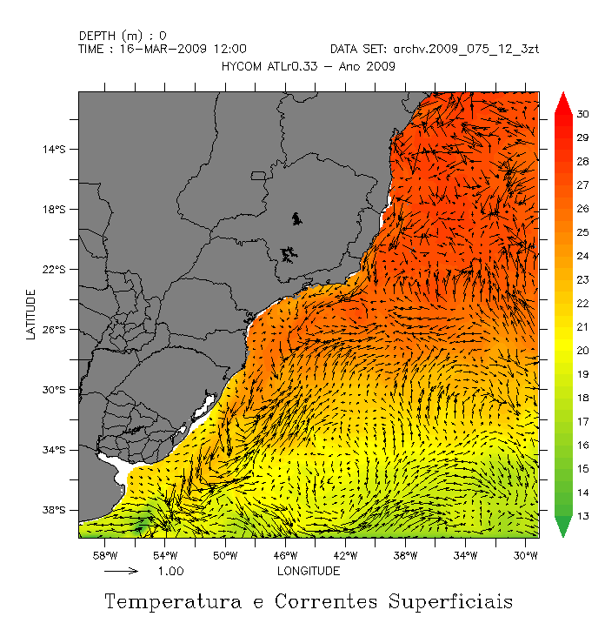
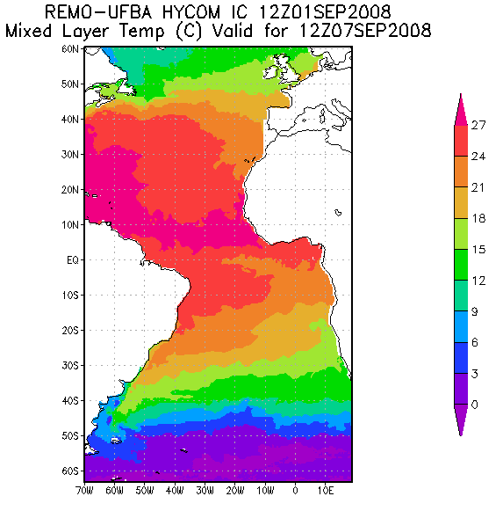
On Sep 1, 2008 daily 7-day forecasts without assimilation forced by NCEP GFS 1º resolution were initiated. The 24 h ocean forecast was saved as the the restart file for the next 7-day forecast
On 15 March 2009 pre-operational forecast swith HYCOM 1/12 º version 2.1.34 and Mellor and Ezer assimilation scheme (M&E) were initiated.

Slide 8
Assimilation with prescribed weights and synthetic data of T and S
Assimilation in z-coordinates
(Oliveira, Campos e Tanajura, LOM 2007)

Slide 9
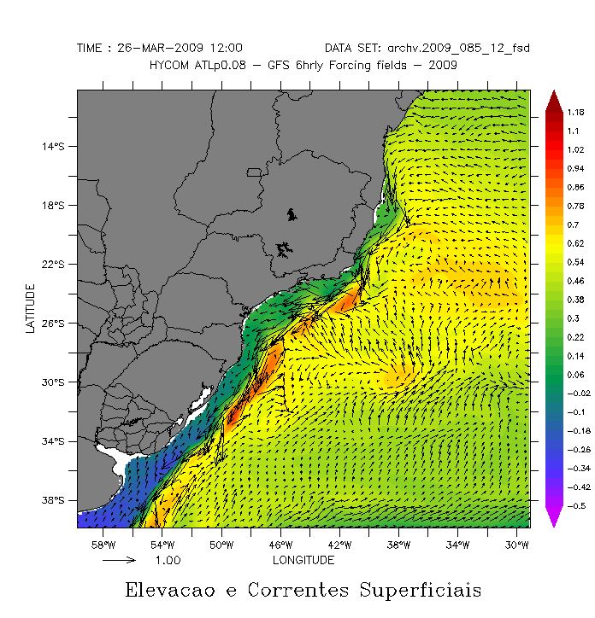
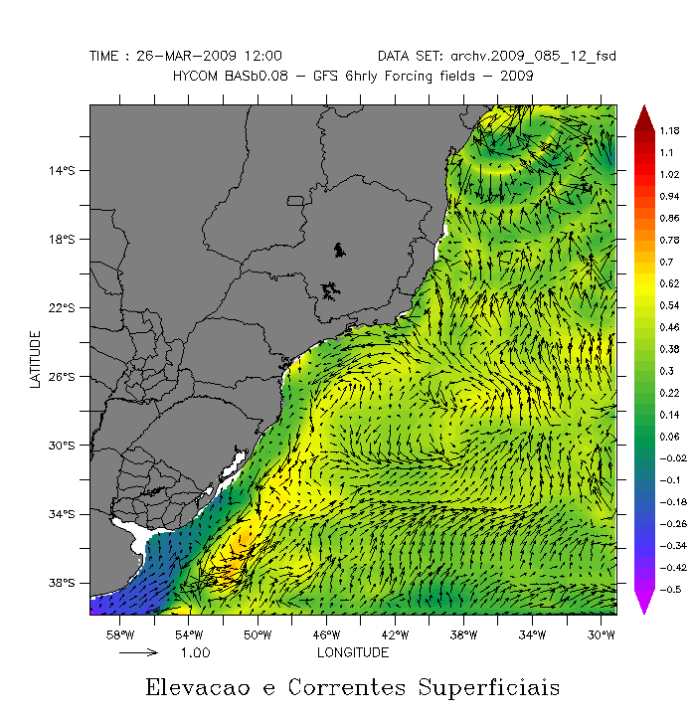
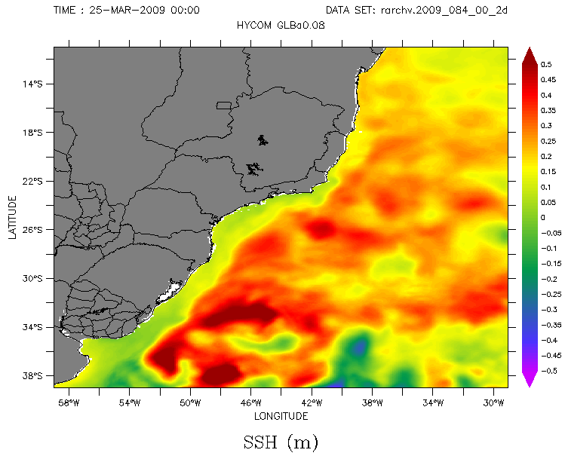
Improvement of SSH and surface circulation when M&E scheme was used.
without assimilation
with assimilation
HYCOM+NCODA

Slide 10
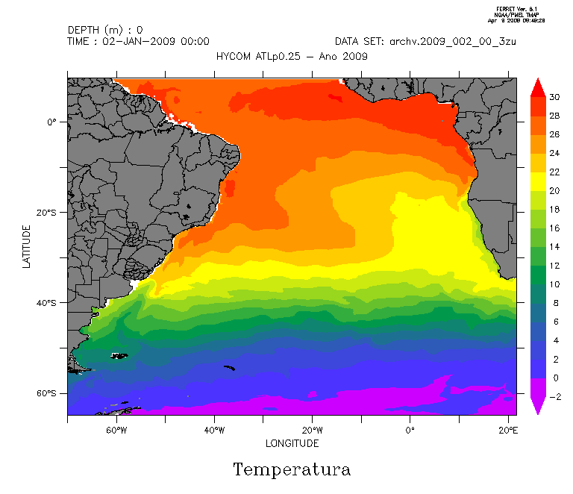
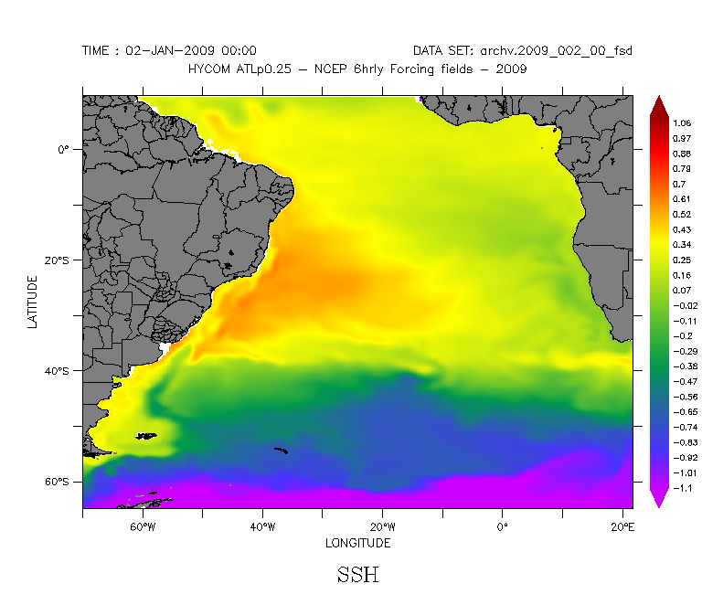
In March 2009 we began to test HYCOM version 2.2.14 with 1/4º and 1/12º with 21 layers.
Temperature
SSH

Slide 11
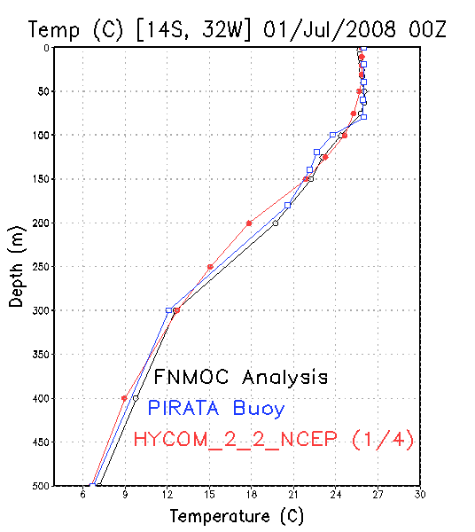
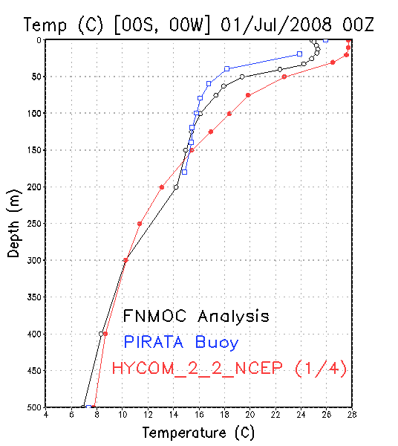
Comparison of 1/4º HYCOM 2.2.14 with PIRATA mooring data
and FNMOC analysis

Slide 12
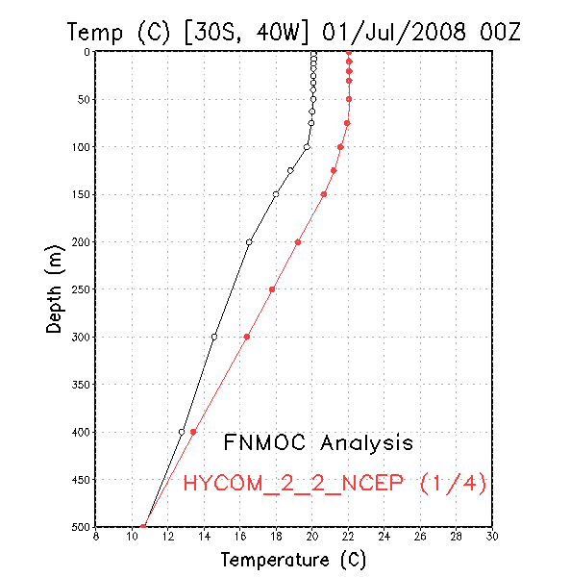
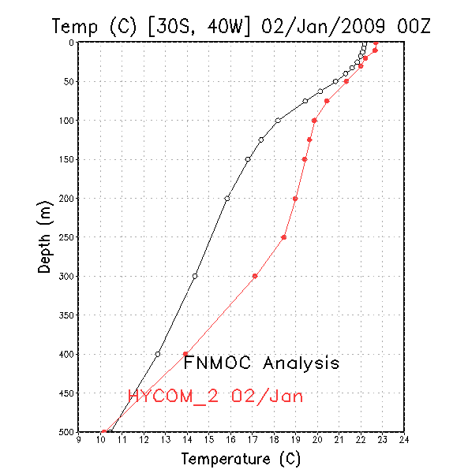
Comparison of 1/4º HYCOM 2.2.14 with FNMOC analysis
3º C

Slide 13
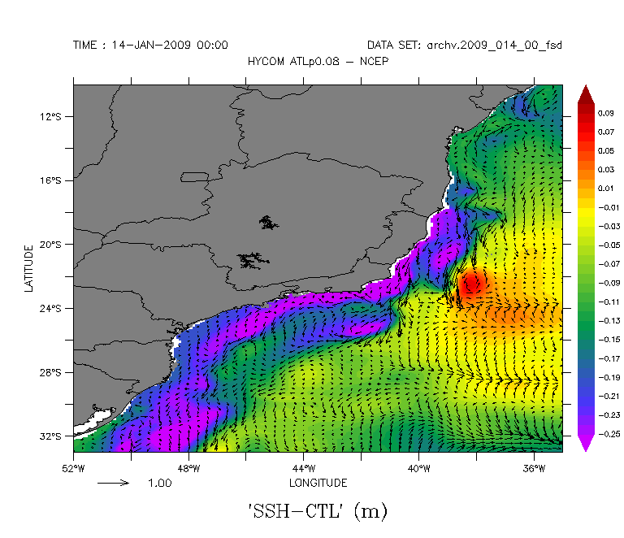
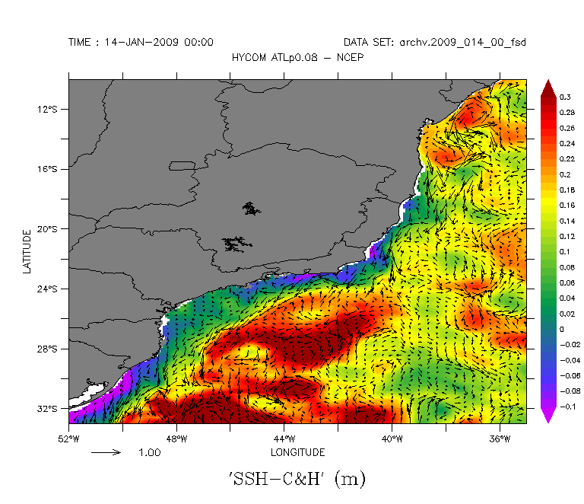
A correction of SSH was implemented using Cooper and Haines (C&H).
SSH given to C&H = SSH mean from HYCOM + SSHA from FNMOC
Control
Cooper & Haines

Slide 14
Present situation of the pre-operational system
1/4º and 1/12º of HYCOM 2.2.14 with C&H
1/4º and C&H is running in DHN-Brazilian Navy
The Mellor and Ezer scheme is under implementation in DHN-Brazilian Navy
A data assimilation system is under development to assimilate PIRATA and ARGO data profiles
We need to go to an assimilation cycle for SSH, SST and in situ data

Slide 15
The Assimilation Cycle
NCEP GFS
I.C. 12 UTC
7-day forecasts at each 6h
00h 06h 12h 18h 24h ........... 168h
Analysis
12UTC
HYCOM
OBS
Quality
Control
Assimilation
Analysis
12UTC
N = N + 1

Slide 16
for any estimation ω. Restricting the class of the analysis to the linear estimation w.r.t to model and observations, the analysis can be sought as
Data Assimilation: Theory (Tanajura & Belyaev Appl.Math Model. 2009)
The following problem is considered:
Find the optimal estimation or analysis of the true value such that
is the model background state
x is the analysis grid point and x_{i,} is the observational points. N(τ) is the number of points of observations at time τ .

Slide 17
The weigths α_{i} = , α( τ, x, x_{i} ) are unknown, and they should be determined using the minimum variance condition. This condition is equivalent to calculate α_{i} such that
If E(ζ) = ζ _{m} , the formula above is equivalent to solving the Wiener-Hopf equation:
K( t,x_{i} , x_{j}) is the covariance function of the errror calculated by
K( t,x_{i} , x_{j}) is parameterized as
where R_{ij} is the dimensionless distance between observational points x_{i} and x_{j}
K( t,x, x_{j}) is estimated using the Fokker-Planck equation and histogram technique
Since the model is not unbiasied, the model bias is estimated a priori in each time step by

Slide 18
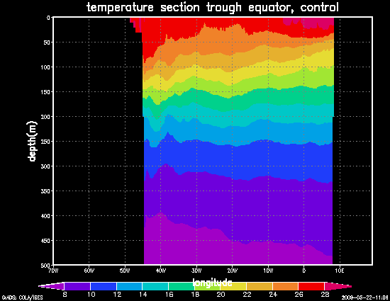
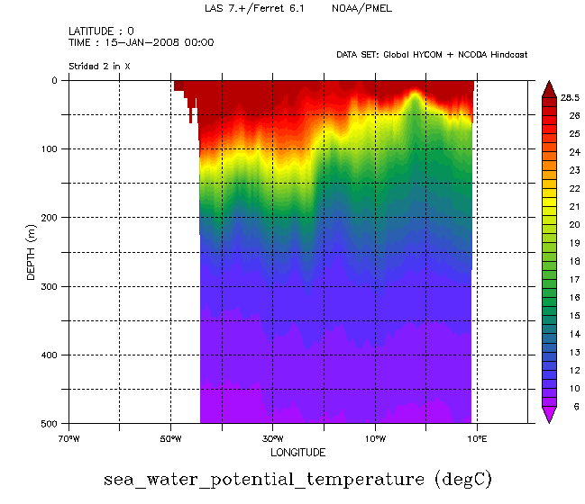
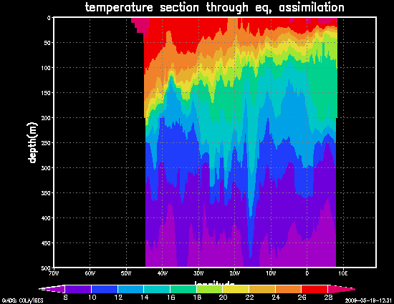
Control
HYCOM+NCODA
Jan 15, 2008
ARGO and PIRATA
Assimilation

Slide 19
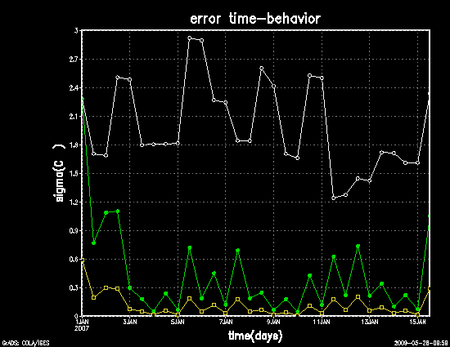
1-15 Jan 2008 Assimilation run
Pirata observation – HYCOM 1/3º
free run error
1d-forecast error
Analysis error

Slide 20
Anomalous 2008 Winter-time Penguins Travel Towards Tropical South Atlantic
Penguin Reports on the News
September 2008
Paraíba = 05
Sergipe = 26
Alagoas = 14
17-31 July 2008
Salvador = 370
Espírito Santo = 220
São Paulo = 200
25 June 2008
02 Penguins São Sebastião-SP
08 June 2008
About 65 penguins, mostly dead, appeared near the Uruguay coast

Slide 21
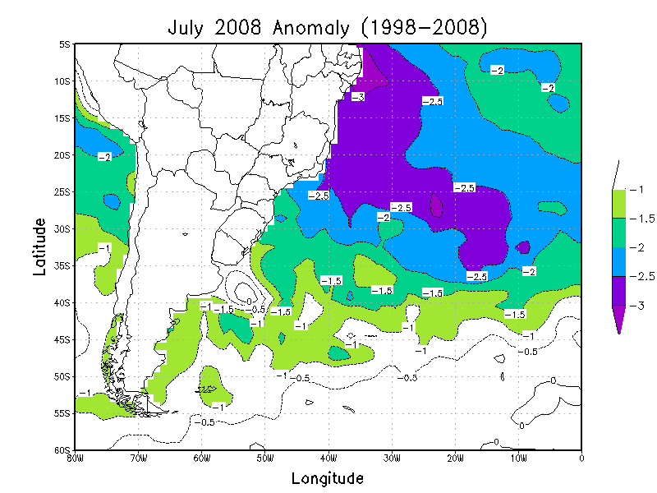
SST cold anomalies were identified to move northward along Brazlian shore from April to July 2008. Cooler areas were located near the coast of Espirito Santo, Bahia, and the northeast states in July 2008.

Slide 22
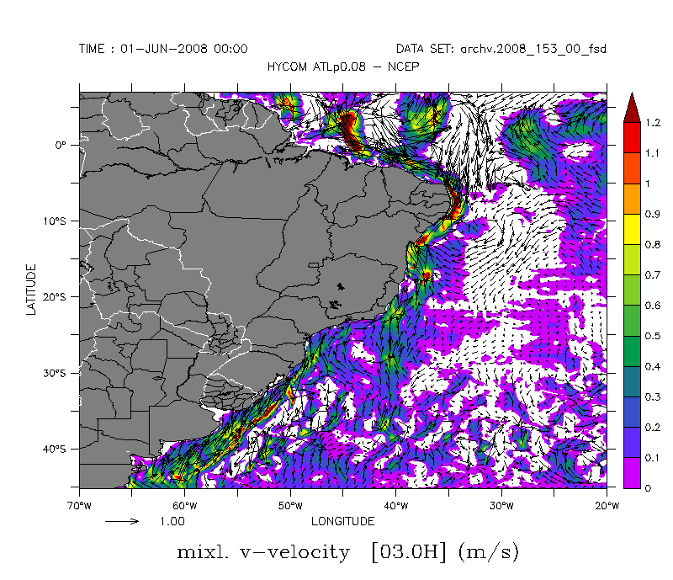
HYCOM 1/12 grid

Slide 23
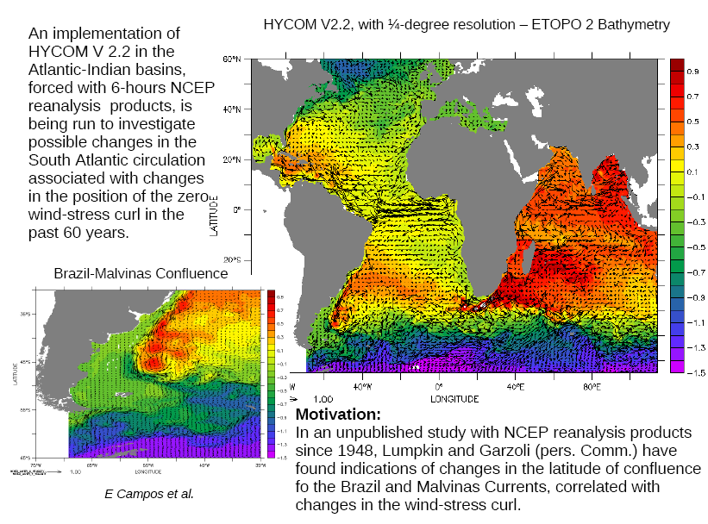
New experiments with HYCOM (E. Campos et al.)

Slide 24
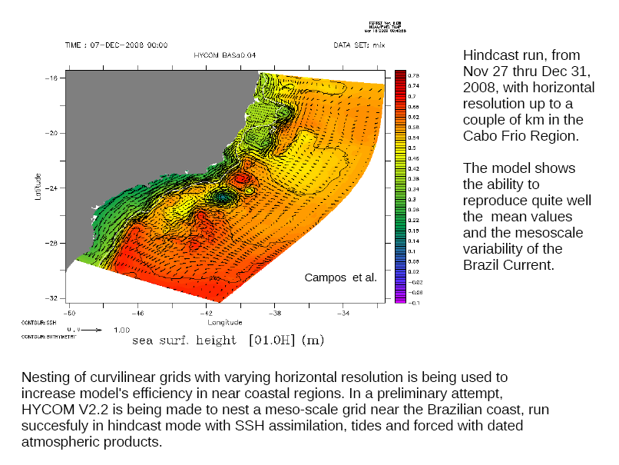

Slide 25
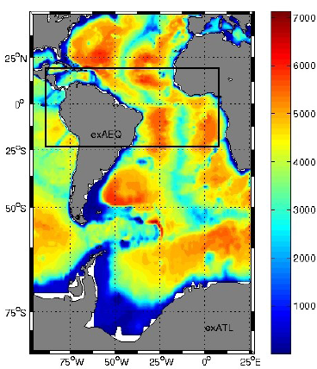
A Numerical Study of the Influence of the Amazon River Plume in the Dynamics of the Western Equatotial Atlantic (G. Ruggiero & I. Soares)

Slide 26
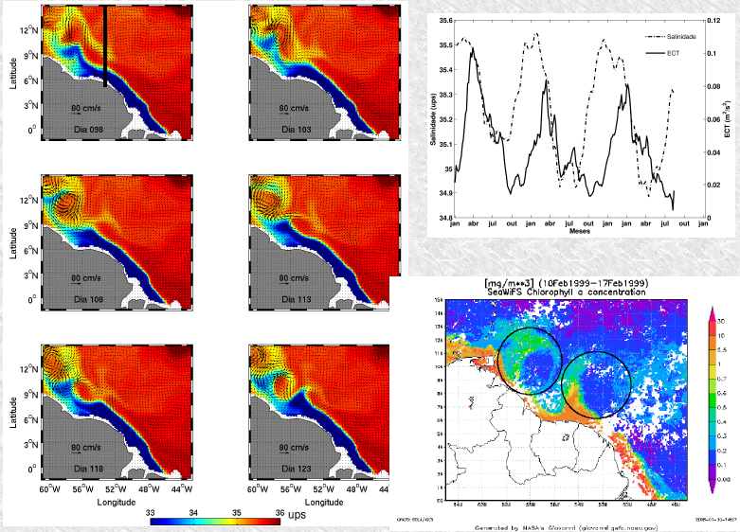
NE Winds

Slide 27
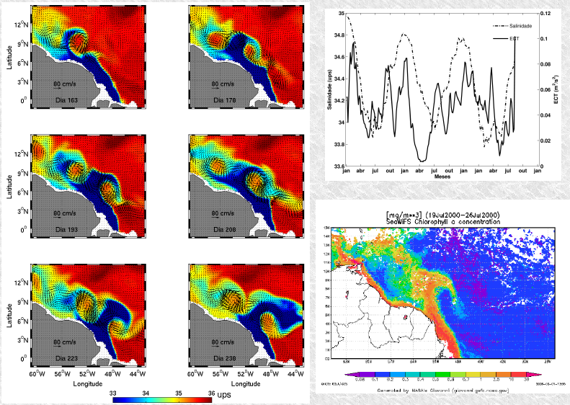
SE Winds

Slide 28
Next Steps
Implement an automatic data quality control system
Implement the Extended Kalman Filter in the pre-operational forcast system
Validate the forecasts taking the RMS w.r.t. observations (and independent data not used in the assimilation)
Do experiments to look for a better model configuration including new domains, resolutions and lateral boundary conditions
Investigate the physical processes associated with the Amazon and Tocantins rivers plume, the variability of the Brazil Malvinas Confluence, the bifurcation of the SEC, ......

