Slide 1
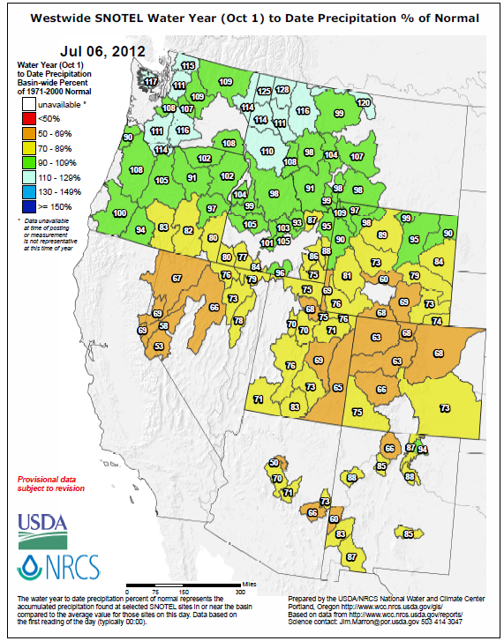
AASC Partnership Presentation (Sandestin Golf & Beach Resort) 10:30 AM, Wednesday, 11 July 2012
AASC Partnerships
Update
By
Jan Curtis, Meteorologist & Applied Climatologist
NRCS - National Water & Climate Center

Slide 2
NETWORKS
SNOTEL – Resource ceiling limitation quickly approaching
Snow Courses – Phasing out? (~25% to convert to SNOTEL)
SCAN – Unfunded but……..

Slide 3
Available by 1 October 2012

Slide 4
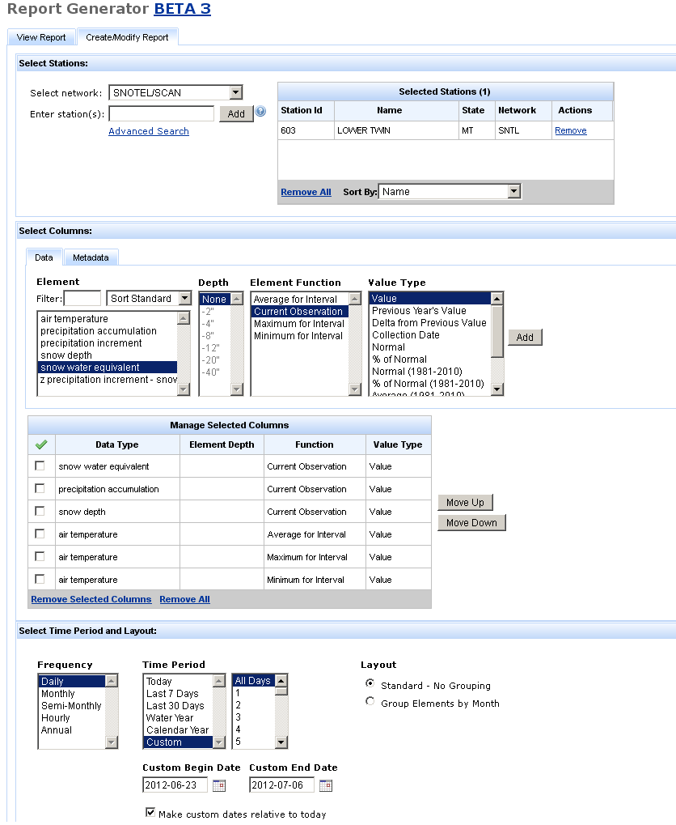

Slide 5
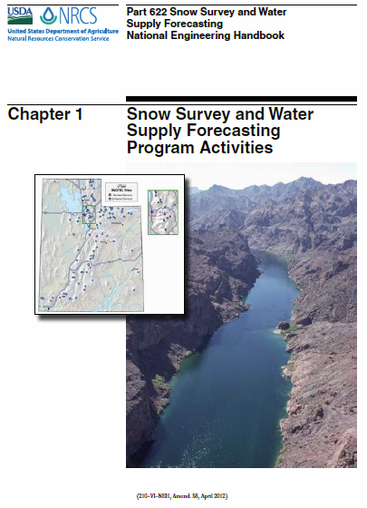
Chapter 1: Program Activities
Chapter 2: Data Parameters
Chapter 3: Data Site Selection
Chapter 4: Installation and Sensor Configuration
Chapter 5: Maintenance and Calibration
Chapter 6: Data Management
Chapter 7: Water Supply Forecast
Chapter 8: Standards and Specifications
Completed
Pending Final Draft

Slide 6
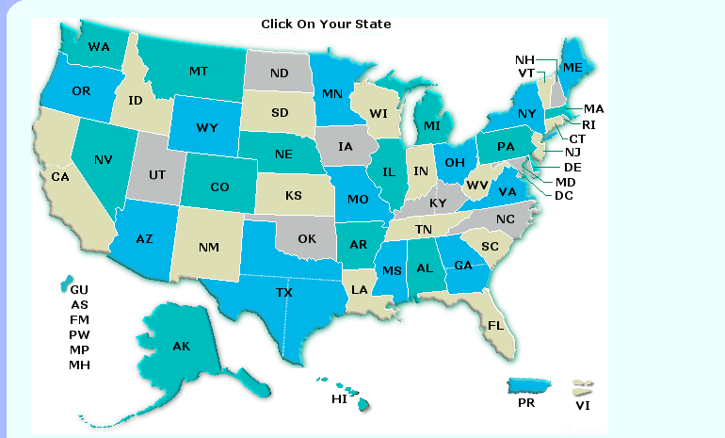
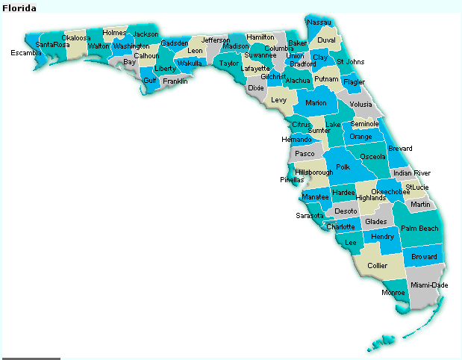
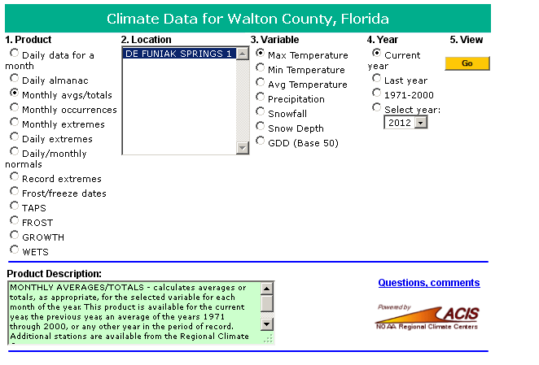
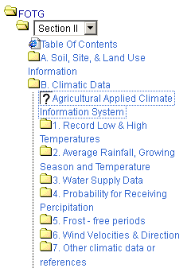
AgACIS
New: Now contains inactive station data
Add’l Features
http://efotg.sc.egov.usda.gov/efotg_locator.aspx - Public Access

Slide 7
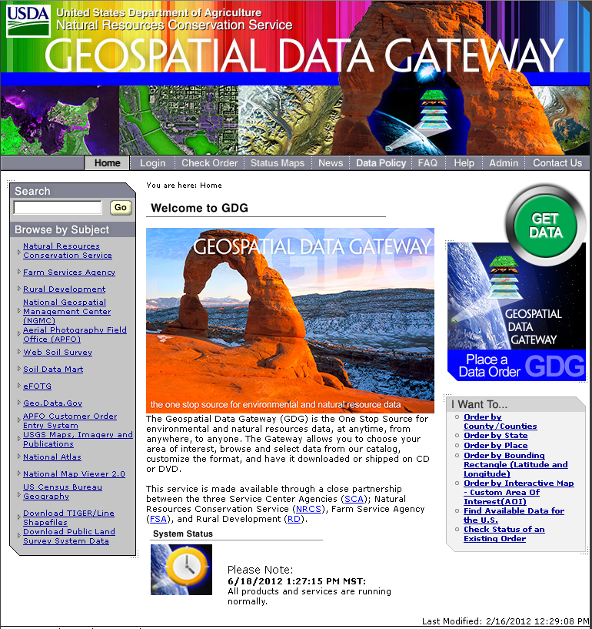
PRISM Normals
1971-2000 Finally Available
1981-2010 Available soon
Daily 4x4km Available soon
(1960-2006)
http://datagateway.nrcs.usda.gov/ ← Free public access

Slide 8
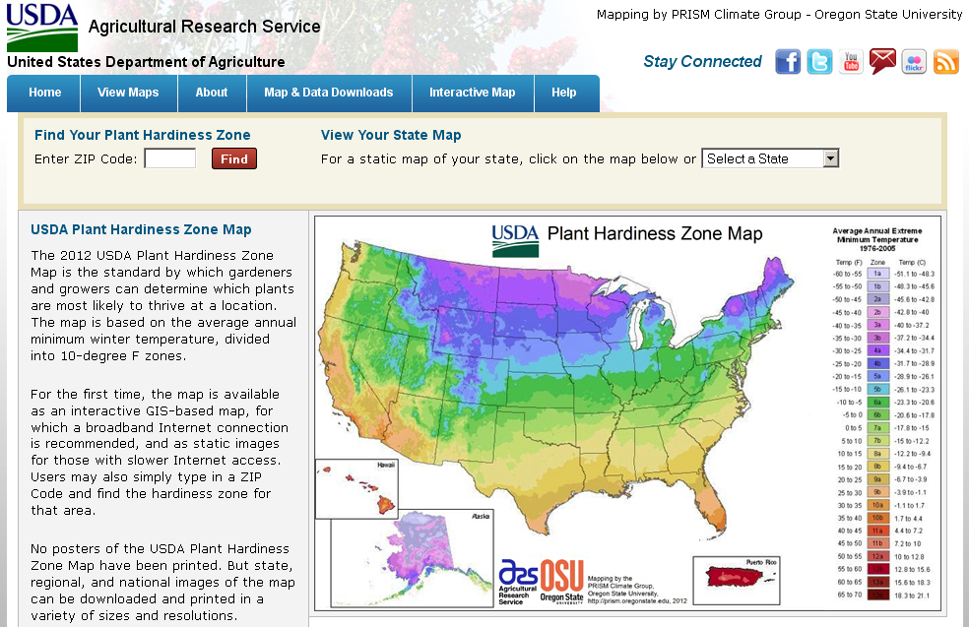
This
Year →
New 2-Year CESU Award to PRISM Group → Automated SNOTEL QC
Currently:

Slide 9
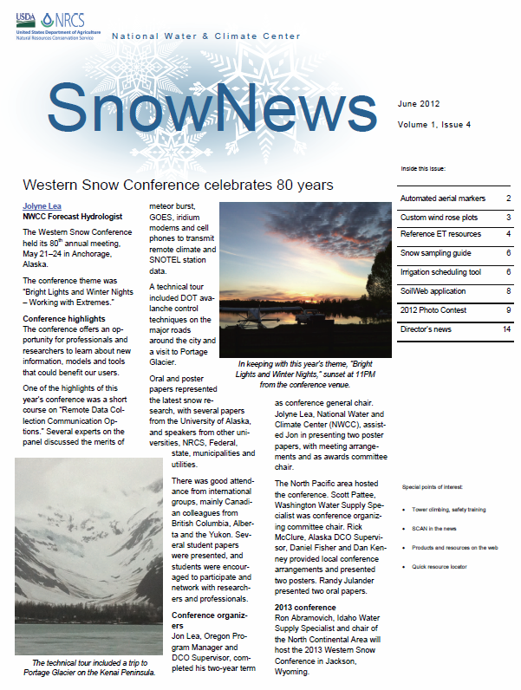
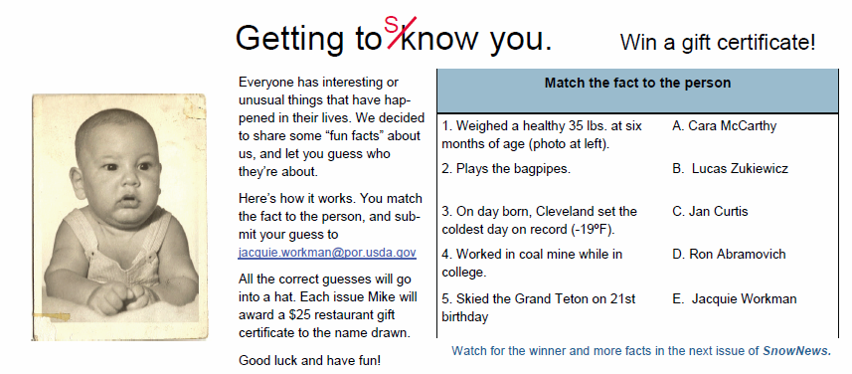
Invitation
To
Contribute
Yes, that picture is yours truly!

Slide 10
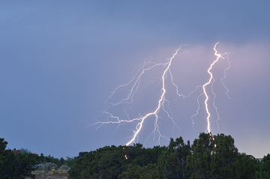
Thank You
Jan Curtis
Natural Resources Conservation Service
National Water & Climate Center
1201 NE Lloyd BLVD., Suite 802
Portland, OR 97232
(503) 414-3017
jan.curtis@por.usda.gov
Photos taken near Santa Fe

